Slide 1
Energy Infrastructure Risk Modeling
Neelanga Thelasingha | ITWS6600 Data Analytics | 10/24/2023

Slide 2
INTRODUCTION
Energy infrastructure - Includes generation, transmission etc. - Failure has a damaging impact on health, safety, security and well being of society.
Modelling risk is critical.
Risk
Hazards
Vulnerabilities
Notes:
Health, national security, well beign.

Slide 3
INTRODUCTION
Hazards
Severe Weather Events:
Hurricanes/Typhoons/Cyclones - lightning
Tornadoes
Snowstorms/Ice Storms
Earthquakes
Floods
Wildfires
Volcanic Eruptions
Geomagnetic Storms
Tsunamis
Droughts
Landslides
Cyberattacks
Physical Attacks -terrorism
Technical Failures
Human Errors
Fuel Supply Disruptions
Regulatory and Policy Changes
Infrastructure Aging
Supply Chain Disruptions
Environmental Regulations
Social and Political Unrest
Economic down-turns and financial crisis

Slide 4
PROBLEM
Hazards have self-excitation – earthquakes increase the probability of happening aftershocks.
Hazards have mutual excitation – Rainstorms increases probability of floods occurring – Earthquakes increases probability of landslides occurring
Hazard 1
Vulnerability
Failure
Excitation
Vulnerability
Hazard 2
Notes:
Health, national security, well beign.

Slide 5
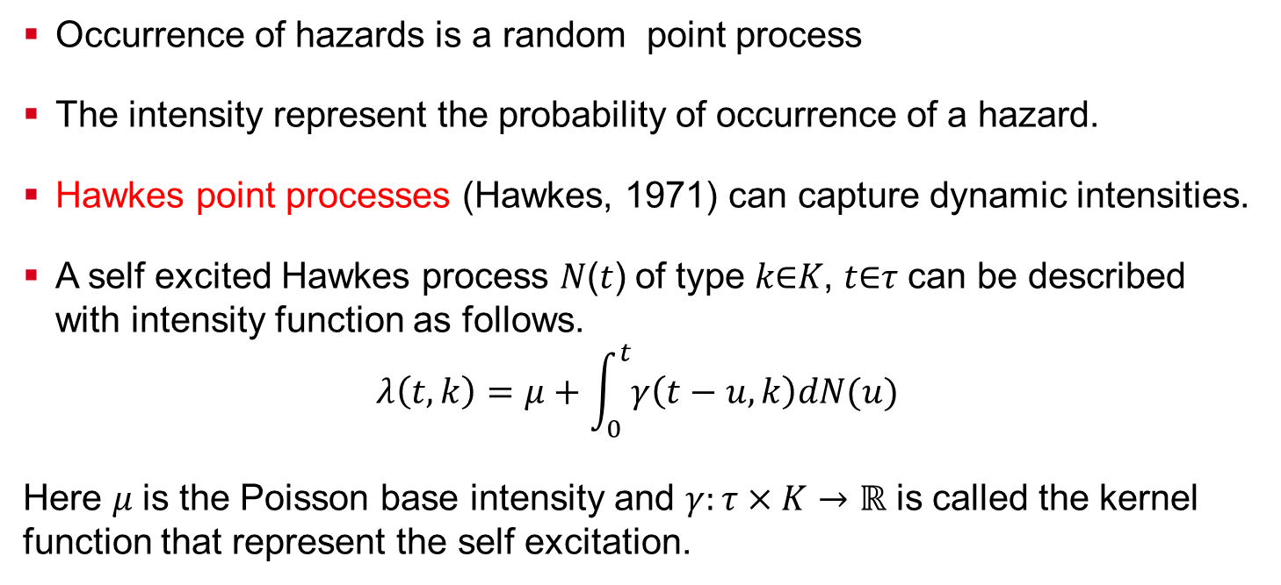
HYPOTHESIS 1 – HAZARD MODEL
Occurrence of hazards is a random point process
The intensity represent the probability of occurrence of a hazard.
Hawkes point processes (Hawkes, 1971) can capture dynamic intensities.
A self excited Hawkes process 𝑁(𝑡) of type 𝑘∈𝐾, 𝑡∈𝜏 can be described with intensity function as follows.
$$λ\left(t,k\right)=μ+\int_{0}^{t}{γ\left(t−u,k\right)dN(u)}$$ Here 𝜇 is the Poisson base intensity and $γ:τ×K→ℝ$ is called the kernel function that represent the self excitation.
Notes:
Each hazard has features that can be measured in addition to it occurrence . (severity of an earthquake, rainfall amount, snowfall inches) Therefore, it can be represented by a marked point process (Li, 2021). This can be an exponentially decaying terms to represent decaying excitation.

Slide 6
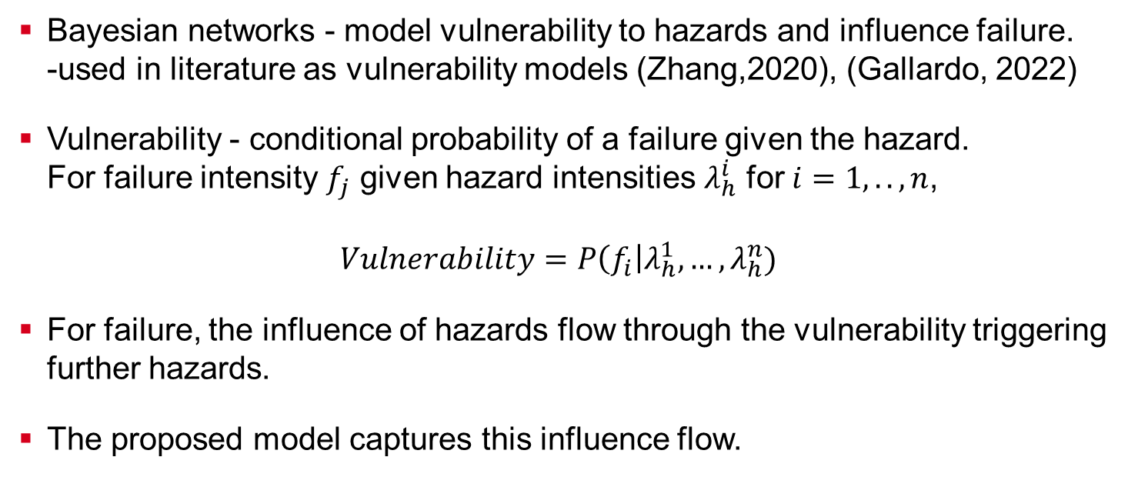
HYPOTHESIS 2 – VULNERABILITY MODEL
Bayesian networks - model vulnerability to hazards and influence failure. -used in literature as vulnerability models (Zhang,2020), (Gallardo, 2022)
Vulnerability - conditional probability of a failure given the hazard. For failure intensity $f_{j}$ given hazard intensities $λ_{h}^{i}$ for $i=1,..,n$, $Vulnerability=P\left(f_{i}\right|λ_{h}^{1},…,λ_{h}^{n})$
For failure, the influence of hazards flow through the vulnerability triggering further hazards.
The proposed model captures this influence flow.
Notes:
Each hazard has features that can be measured in addition to it occurrence . (severity of an earthquake, rainfall amount, snowfall inches) Therefore, it can be represented by a marked point process (Li, 2021). This can be an exponentially decaying terms to represent decaying excitation.

Slide 7
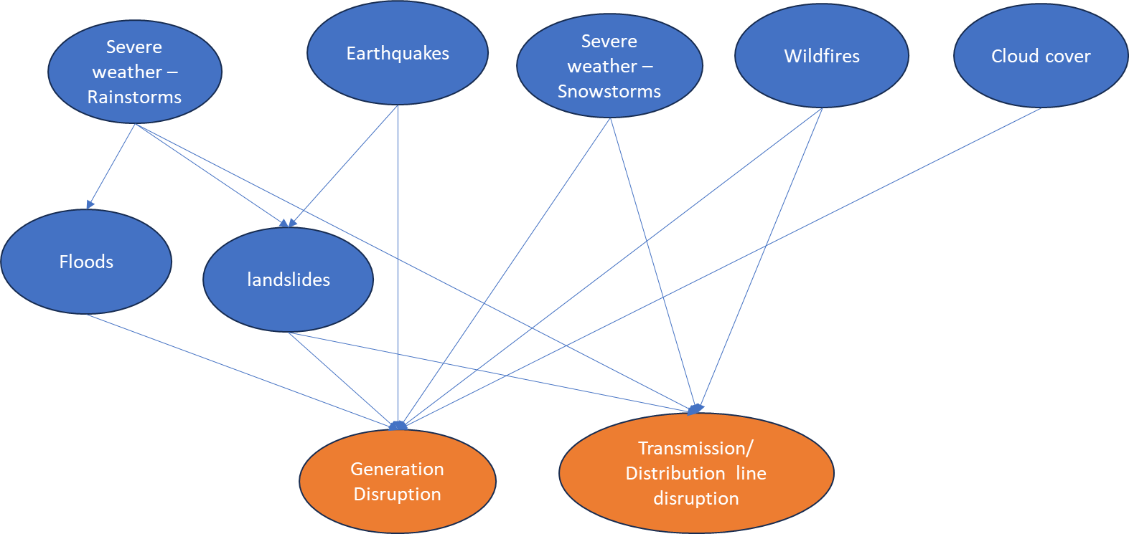
ANALYSIS SCENARIO
Selected geographical area – North-East US - Goal : identify the hazards and vulnerabilities to the energy infrastructure.
Notes:
Each hazard has features that can be measured in addition to it occurrence . (severity of an earthquake, rainfall amount, snowfall inches) Therefore, it can be represented by a marked point process (Li, 2021). This can be an exponentially decaying terms to represent decaying excitation.

Slide 8
ANALYSIS SCENARIO
Selected geographical area – North-East US - Goal : identify the hazards and vulnerabilities to the energy infrastructure.
Notes:
Each hazard has features that can be measured in addition to it occurrence . (severity of an earthquake, rainfall amount, snowfall inches) Therefore, it can be represented by a marked point process (Li, 2021). This can be an exponentially decaying terms to represent decaying excitation.

Slide 9
REQUIRED DATA
Precipitation Data- Rainstorms-Snowstorms – NASA POWER
Cloud- Cover - NASA POWER
Earthquake Data - NASA EARTHDATA
fires Data - National Interagency Fire Center
Floods - NASA EARTHDATA
Disaster declarations
Landslides - Global Landslide Data
Energy Infrastructure data- Homeland Infrastructure Foundation-Level Data - Generation types- locations
Data combination – over timestamps and location coordinates
Notes:
Each hazard has features that can be measured in addition to it occurrence . (severity of an earthquake, rainfall amount, snowfall inches) Therefore, it can be represented by a marked point process (Li, 2021). This can be an exponentially decaying terms to represent decaying excitation.

Slide 10
MODEL ESTIMATION & VALIDATION
Hypothesis 1
Estimate the model parameters of the hazard Hawkes process.
Hypothesis 2
Learn the structure of the Bayesian network that represents influence flow
Prune/ enhance the structure using domain knowledge.
Estimate parameters of the Bayesian network that describes the vulnerability metrics.
Baseline models for benchmarking
Parametric regression models
Decision trees
Neural network models
Notes:
Each hazard has features that can be measured in addition to it occurrence . (severity of an earthquake, rainfall amount, snowfall inches) Therefore, it can be represented by a marked point process (Li, 2021). This can be an exponentially decaying terms to represent decaying excitation.

Slide 11
INTENDED OUTCOMES
Validate Hypothesis 1
Validate that hazard occurrences can be modeled by self exciting processes.
Validate Hypothesis 2
Validate the use of Bayesian networks for vulnerability modelling
Propose and benchmark novel Risk models.
Use the proposed models to derive meaningful inferences on risk in critical infrastructure.
Notes:
Each hazard has features that can be measured in addition to it occurrence . (severity of an earthquake, rainfall amount, snowfall inches) Therefore, it can be represented by a marked point process (Li, 2021). This can be an exponentially decaying terms to represent decaying excitation.

Slide 12
REFERENCES
Li, X., Genest, C., & Jalbert, J. (2021). A self-exciting marked point process model for drought analysis. Environmetrics, 32(8), e2697. https://doi.org/10.1002/env.2697
Alan G. Hawkes, Spectra of some self-exciting and mutually exciting point processes, Biometrika, Volume 58, Issue 1, April 1971, Pages 83–90, https://doi.org/10.1093/biomet/58.1.83
Embrechts, P., Kirchner, M. (2018). Hawkes graphs. Theory of Probability & Its Applications, 62(1), 132–156. https://doi.org/10.1137/s0040585x97t988538
Song, Wenting, et al. "Bayesian network structure learning from attribute uncertain data." Web-Age Information Management: 13th International Conference, WAIM 2012, Harbin, China, August 18-20, 2012. Proceedings 13. Springer Berlin Heidelberg, 2012.
Thank you!
Notes:
Each hazard has features that can be measured in addition to it occurrence . (severity of an earthquake, rainfall amount, snowfall inches) Therefore, it can be represented by a marked point process (Li, 2021). This can be an exponentially decaying terms to represent decaying excitation.

